Slide 1
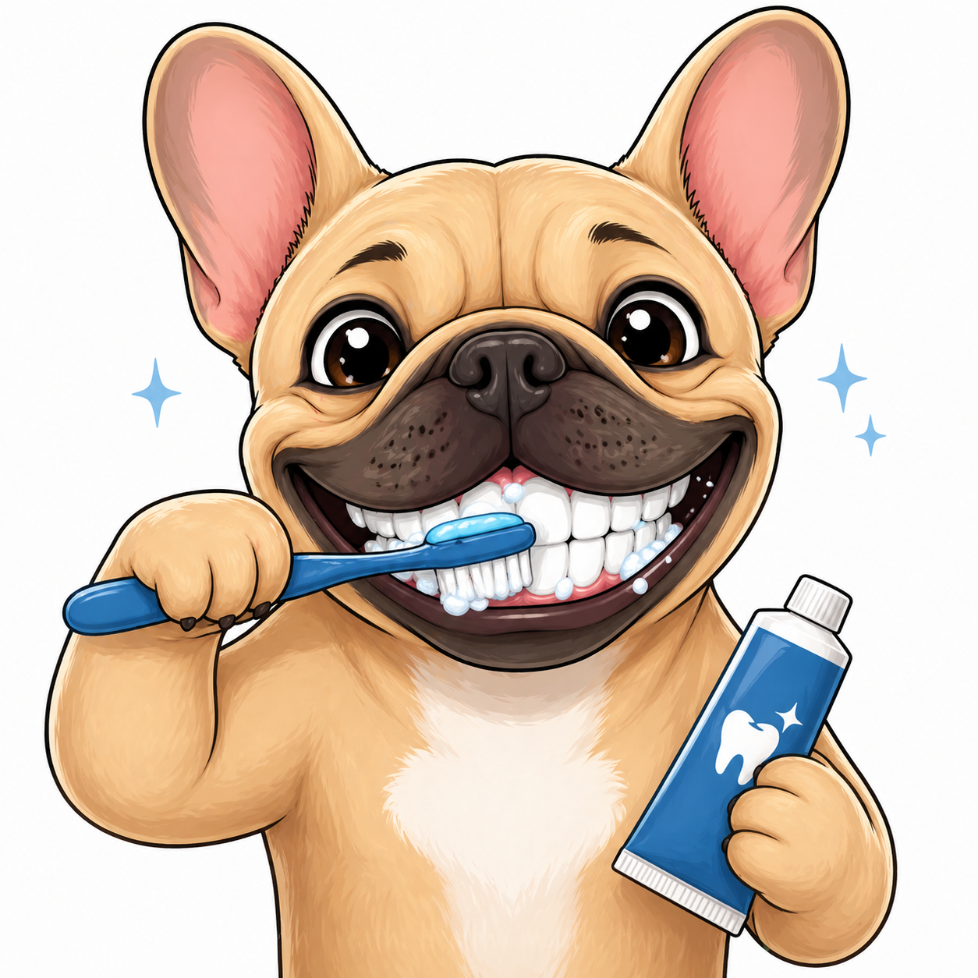
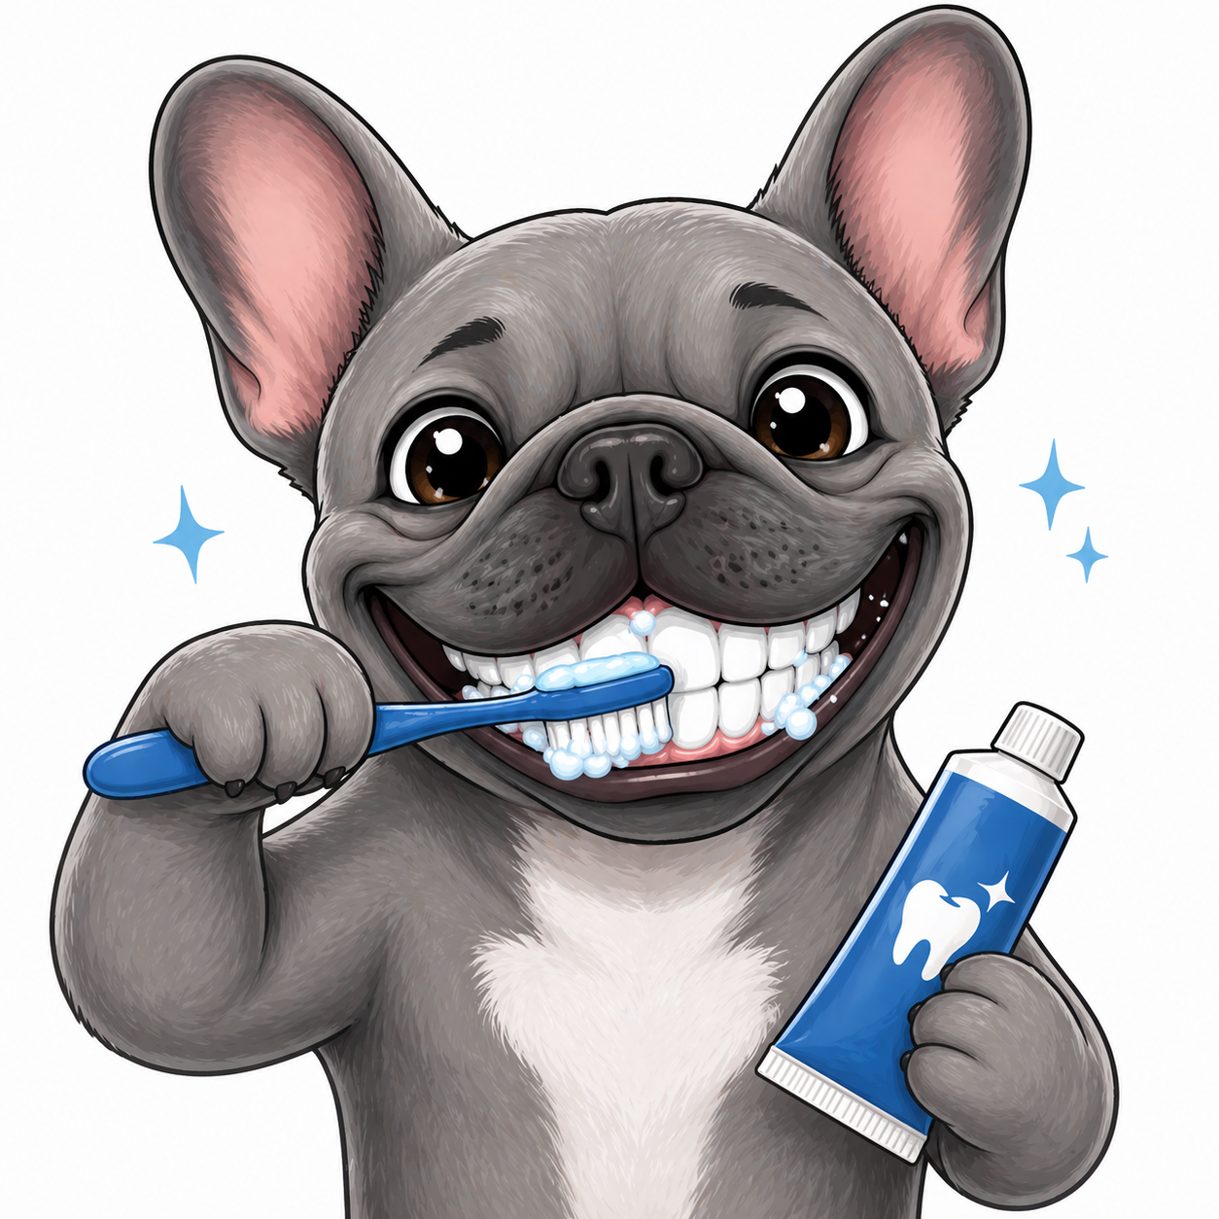
How to take care of your dogs teeth
By Ella
9 years old
3rd year in 4H, 1st year in dog project

Slide 2
Things I will talk about
Dental safe toys
Taking care of your dog after dental surgery
Oral care

Slide 3
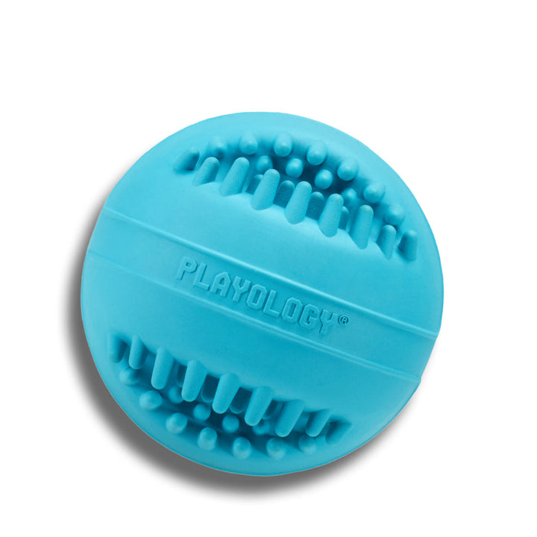
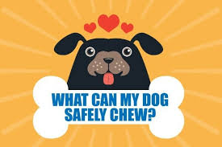
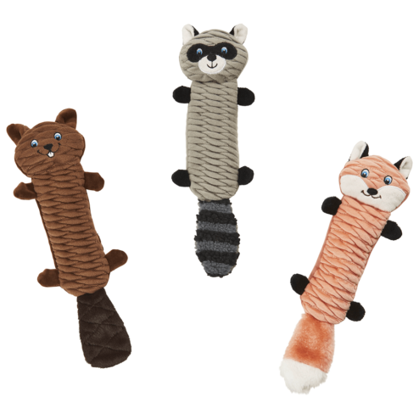
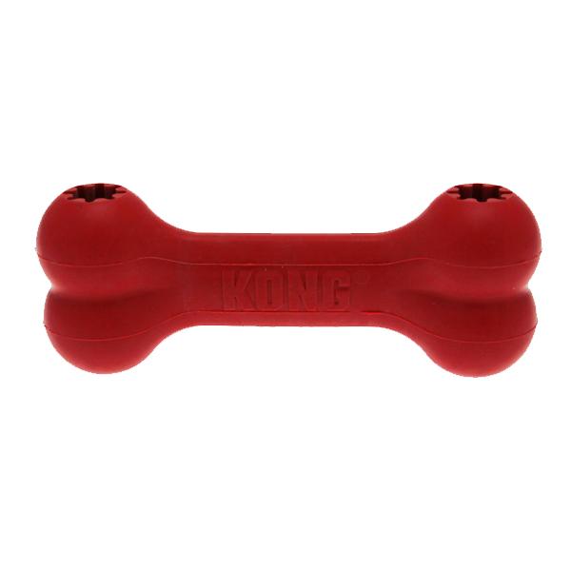
Dental safe toys
All toys should be soft enough that you can stick your finger nail in to it.

Slide 4
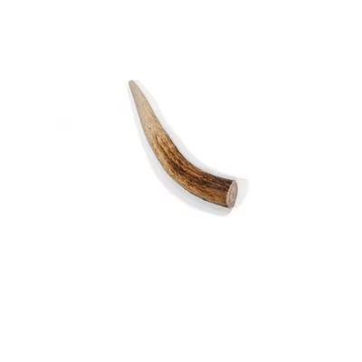
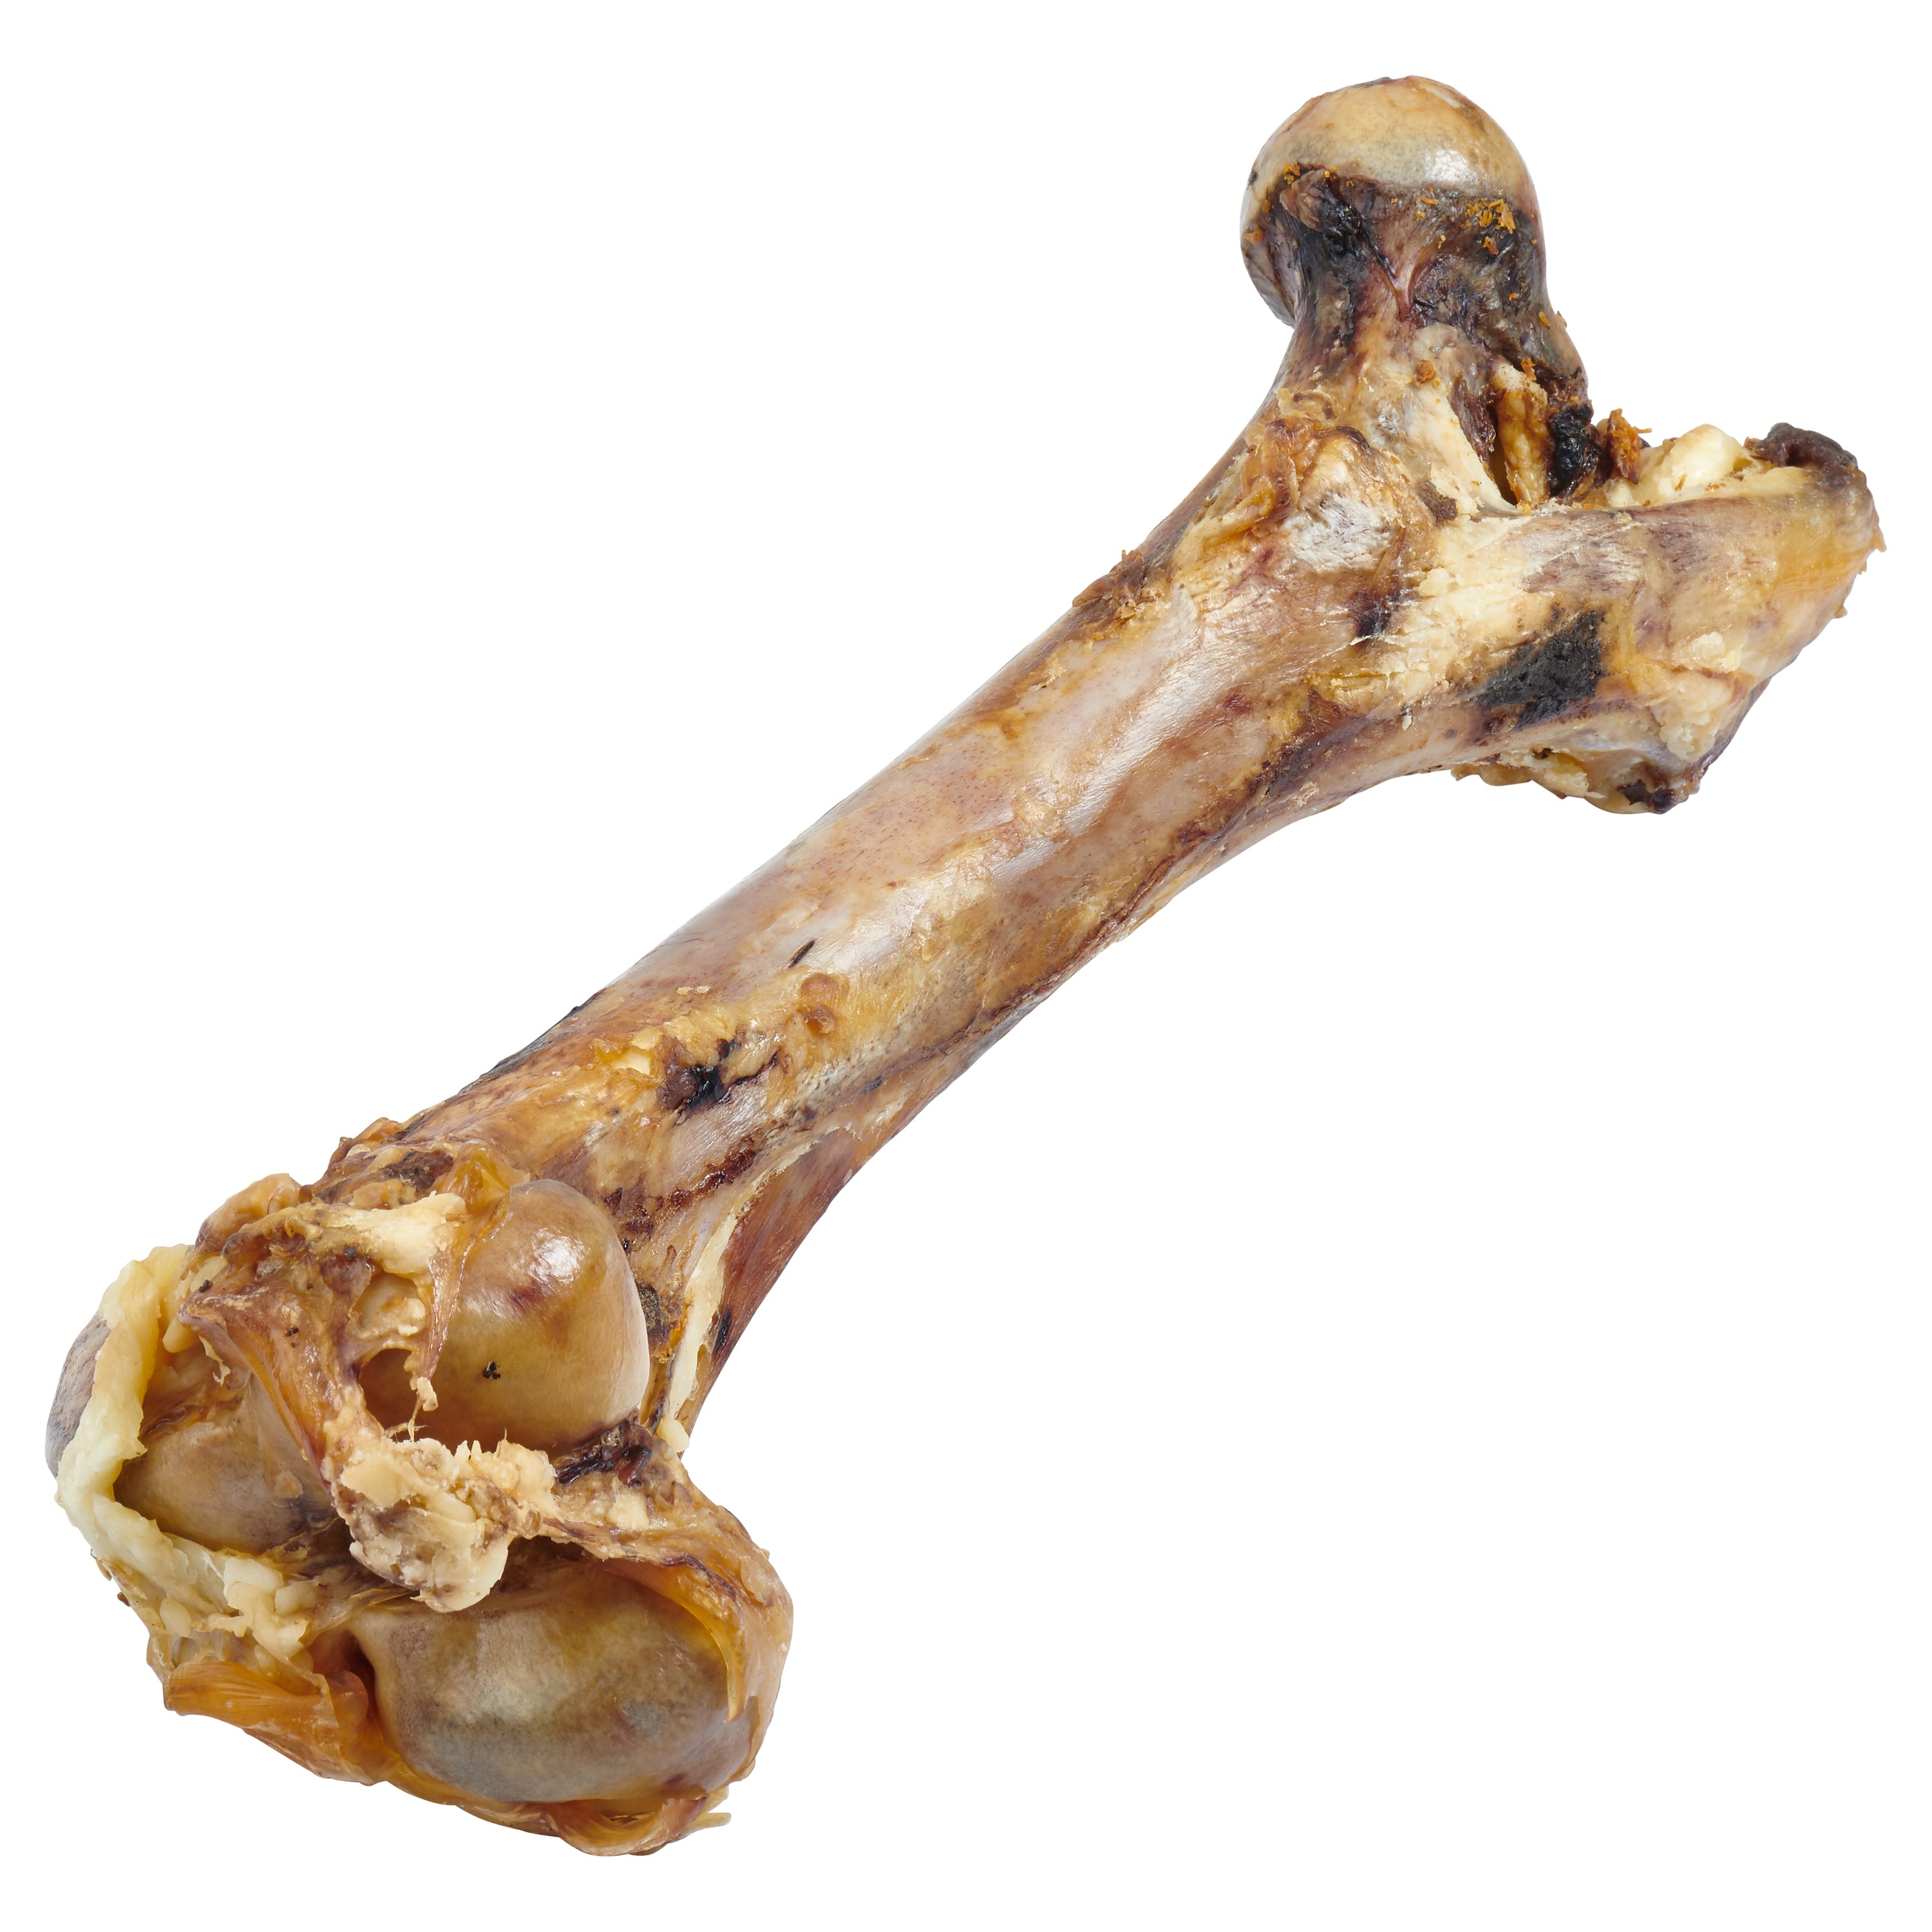
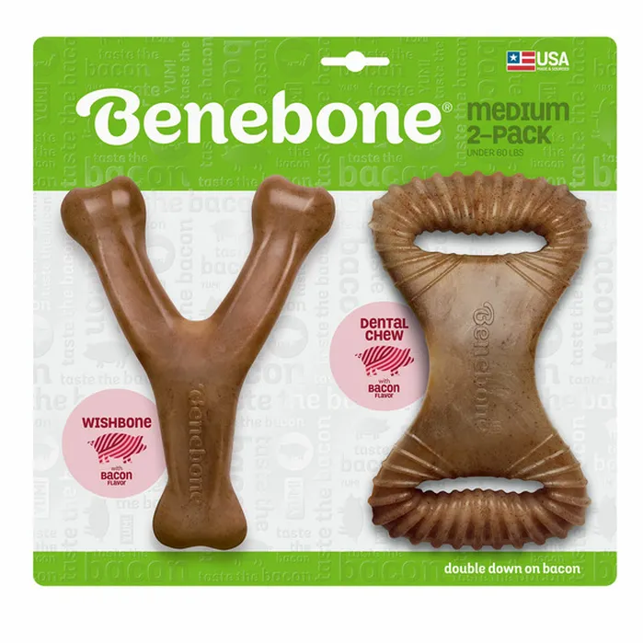
Unsafe dog toys
Things that could brake or crack a dog's tooth

Slide 5
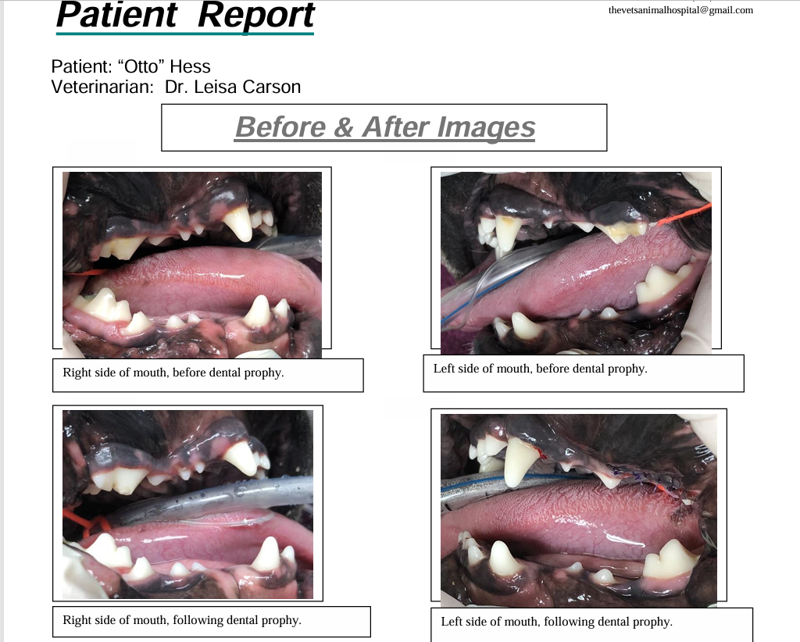
Otto’s Dental Surgery

Slide 6
How I take care of my dog after dental surgery
First, I let my dog rest for about two weeks and I don’t let him chew on any toys. For one week he had to eat soft food.
He had pain medicine for 5 days. He is taking a dental supplement and because the anesthesia bothered his stomach he took a probiotic for a few days after the surgery.

Slide 7
When should I brush my dog’s teeth?
You should brush your dog’s every day ether after you brush your teeth or after they eat

Slide 8
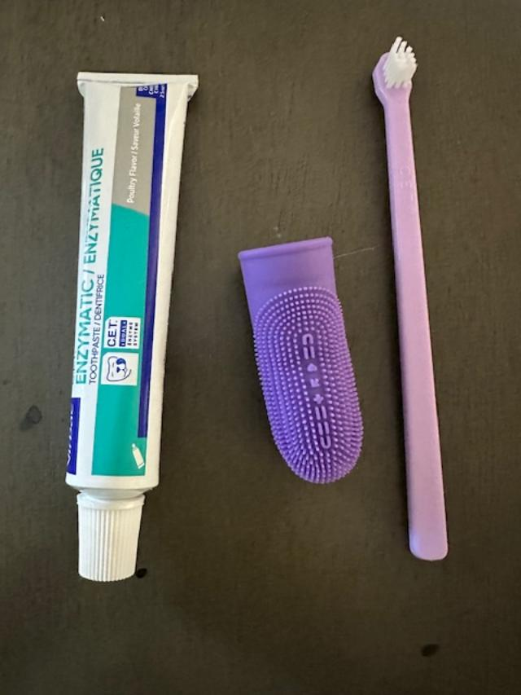
Things you need to brush your dog’s teeth
Clean hands
Tooth brush
Toothpaste
water

Slide 9
My Resources
Dr. Carson

Slide 10
Any questions?

